Slide 1
"Budget Buddy"
Personal Finance Tracker - Trustworthy and Secure
Santhoshi

Slide 2
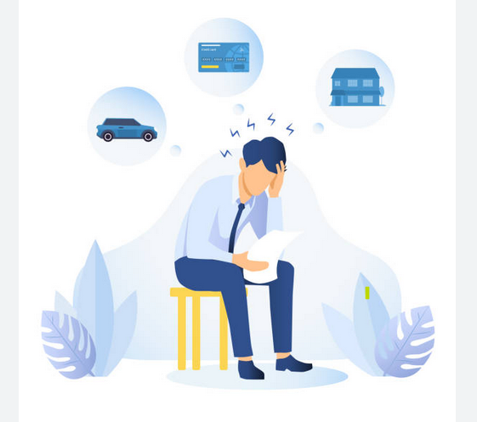

Motivation :
I felt overwhelmed by the complexity of managing my finances.

Slide 3

Can I use my Data Skills
to fix this issue???

Slide 4
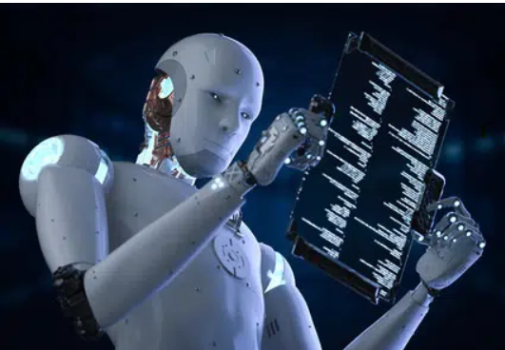
LLM -Large Language Models
Articles
Books
Websites
Prompting Techniques
Best answers

Slide 5
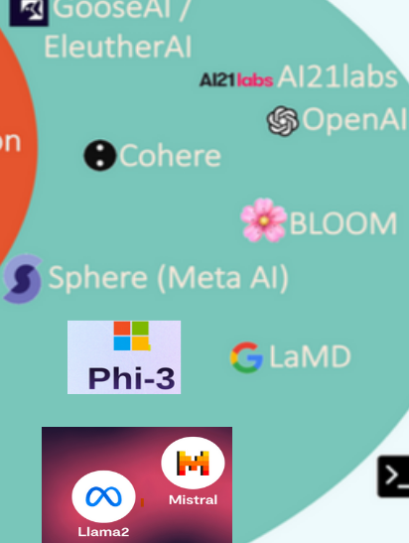
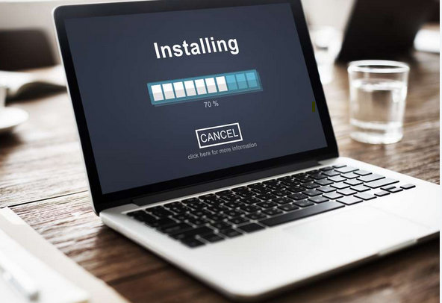
Install the LLM Locally .
Check which Model suits Best to our Project.

Slide 6
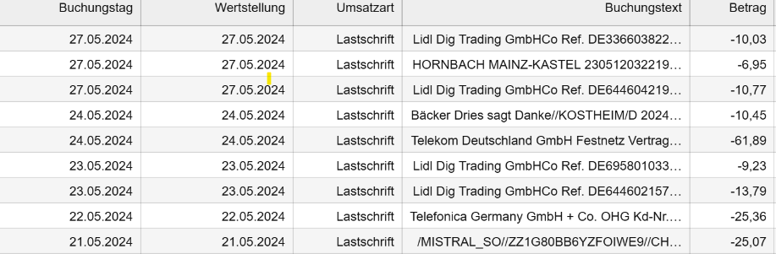
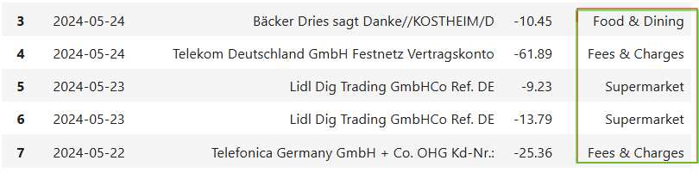
Download Bank Transactions and LLM
2. Data Cleaning
3. Load the LLM
4. Categorization.(Fees & charges,Shopping,ATM Withdrawal etc)

Slide 7
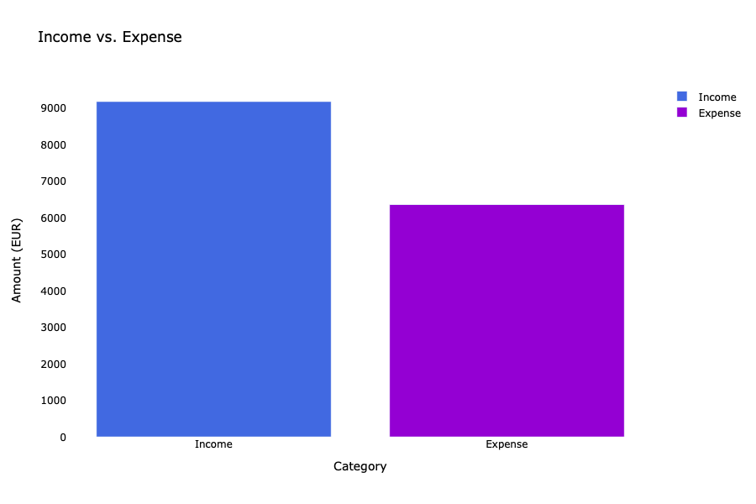
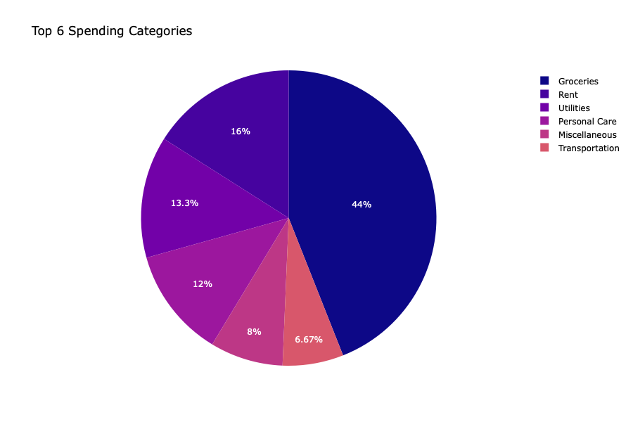
5. Visualization
Check Income & Expenses
Compare Expenses
Identifying Trends
http://127.0.0.1:8009/

Slide 8
Objectives:
Clear Financial Overview
Budget Management
Local dashboard
No leaking of our sensitive data
Enhancements:
Add personal Insights and tips to plan Finances better.
Extending benefit for Others - Develop it into a fully-fledged app.

Slide 9


